Slide 1
IPM IN PADDY

Slide 2
IPM is the intelligent selection and use of pest control tactics that will ensure favourable economic, ecological and sociological consequences.

Slide 3
POP recommendation
Cultivate tolerant varieties.
Monitor the field.
Before taking decision on insecticide application, both pests and natural enemies should be considered.
Avoid spraying during vegetative phase.
Adopt spot application of insecticides.

Slide 4
Research results showed that cultivation of tolerant varieties, conservation of existing NEs together with mechanical and cultural control operations are the “best mix” for rice pest management.

Slide 5
Key Pests of Rice

Slide 6
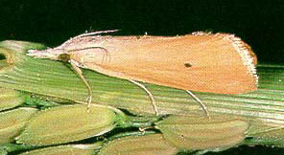
Stem Borer
Stem borer

Slide 7
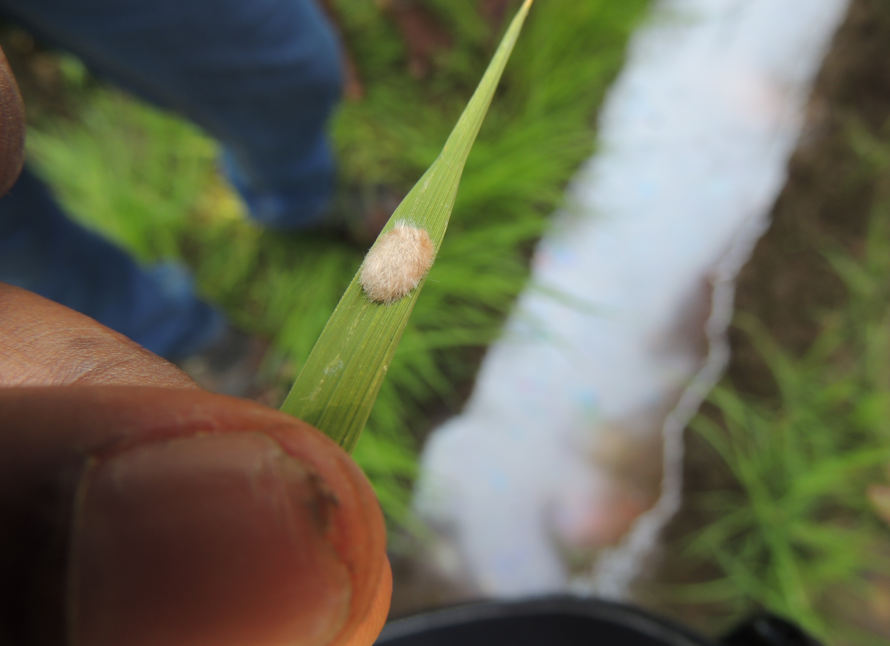

Slide 8
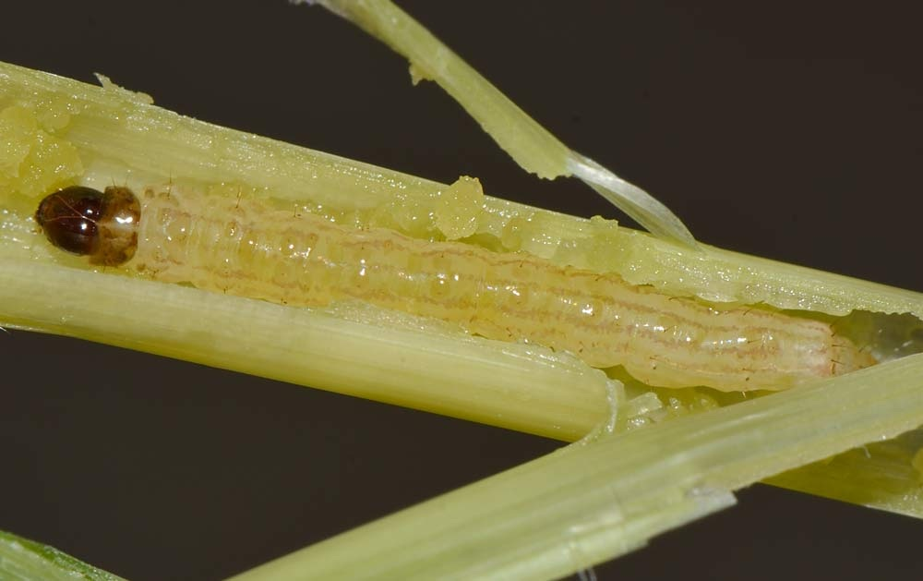

Slide 9
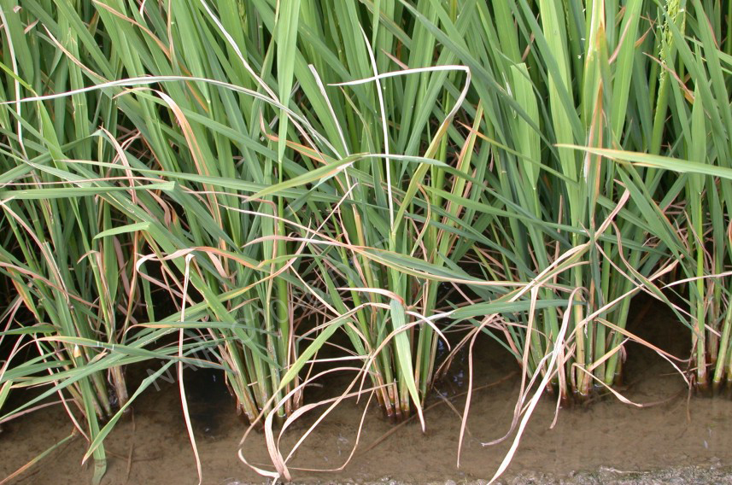

Slide 10
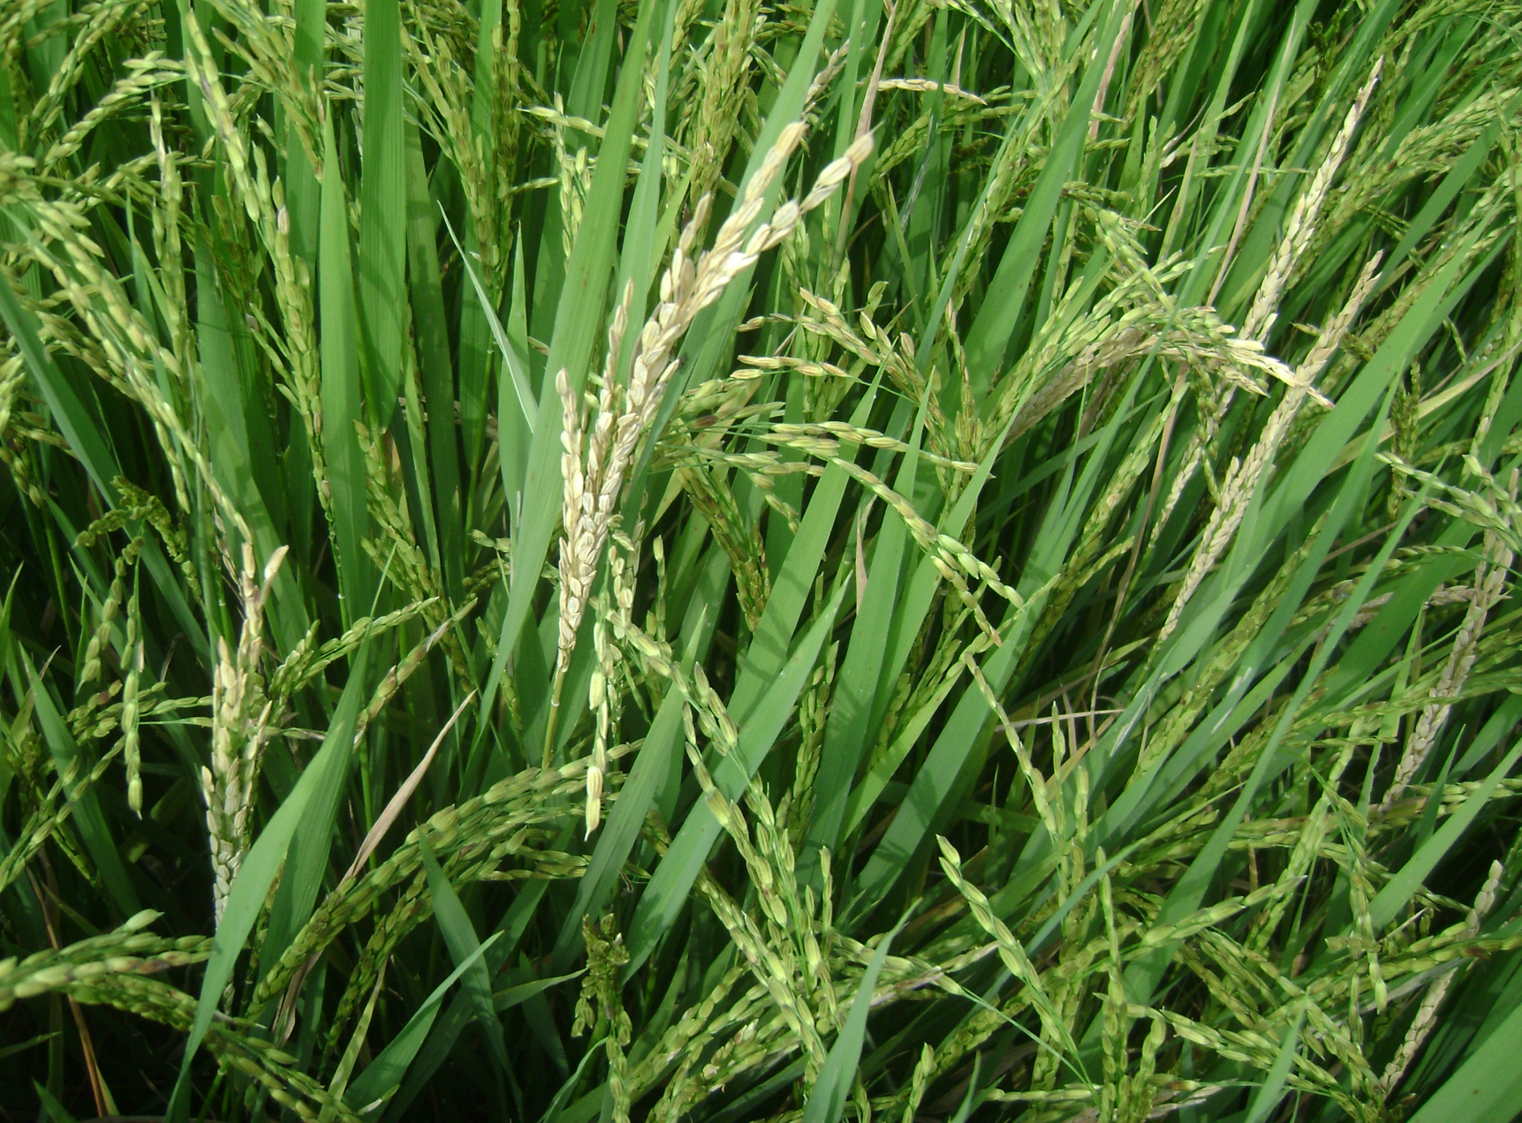

Slide 11
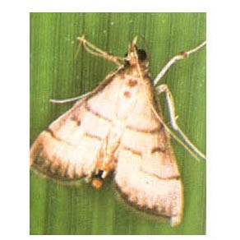
Leaf Roller

Slide 12
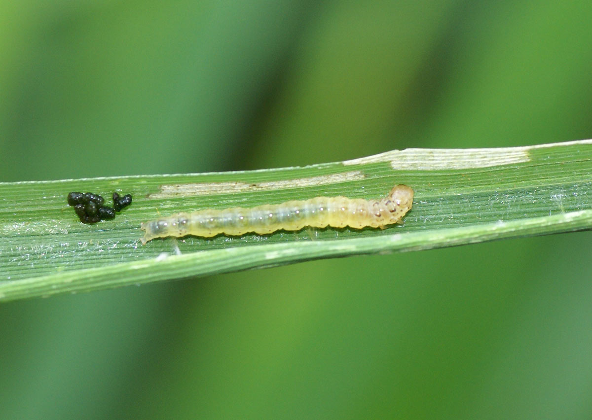

Slide 13
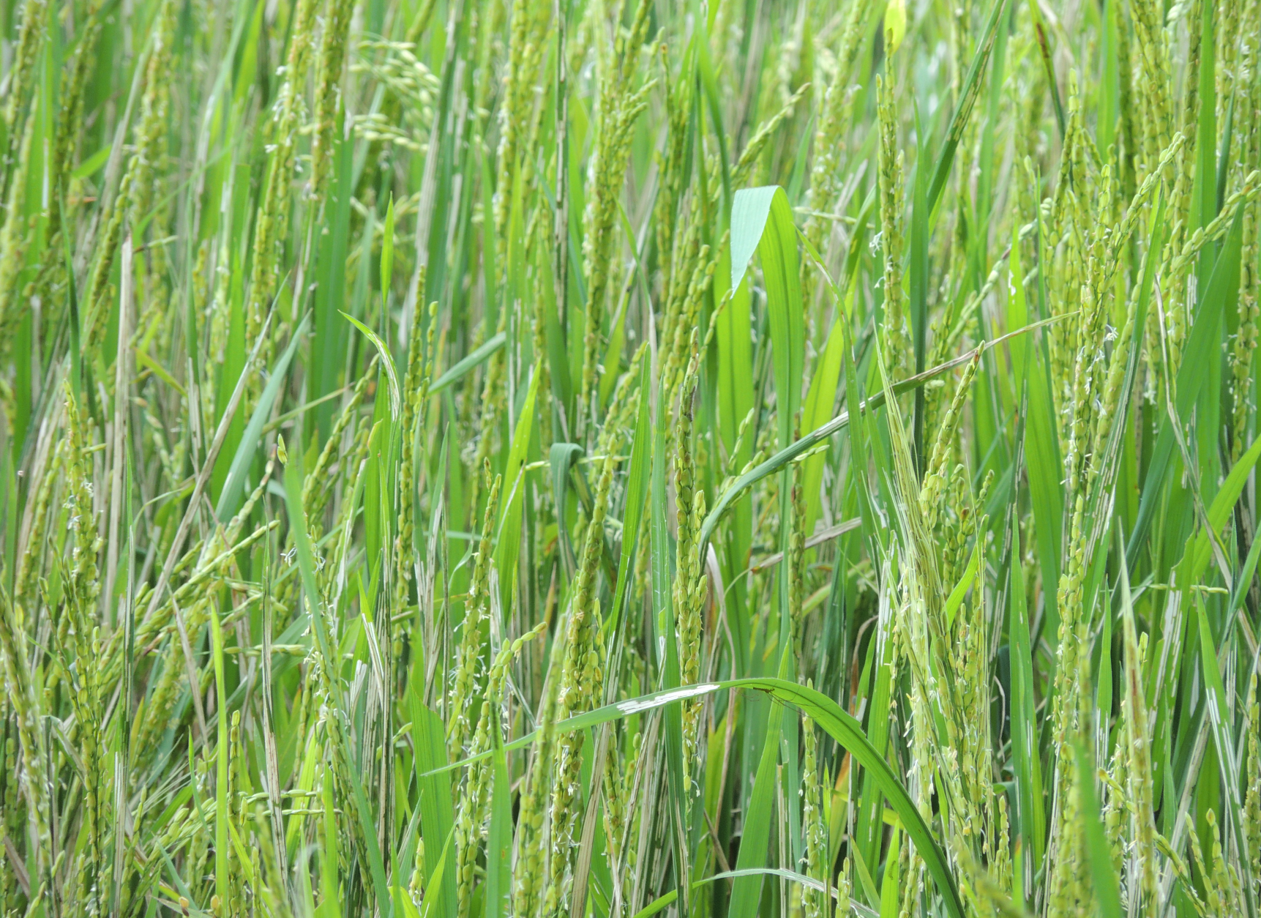

Slide 14
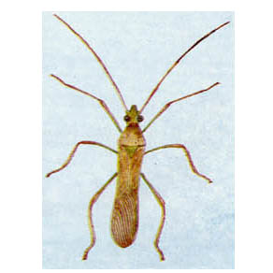
Rice Bug

Slide 15
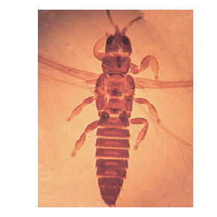
Rice Thrips

Slide 16
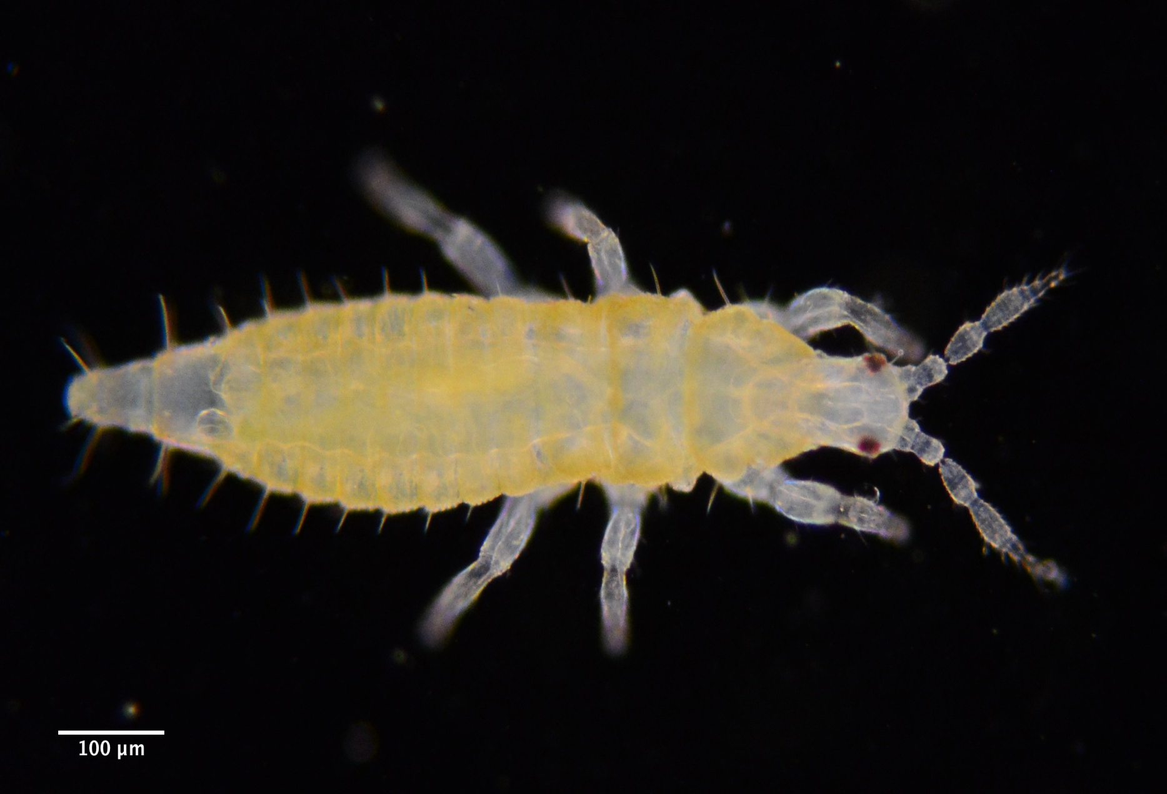

Slide 17
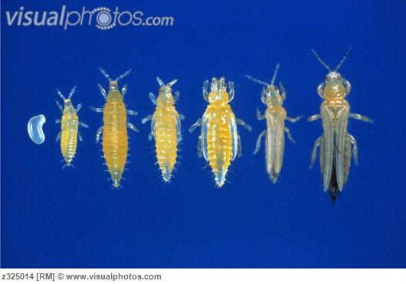

Slide 18
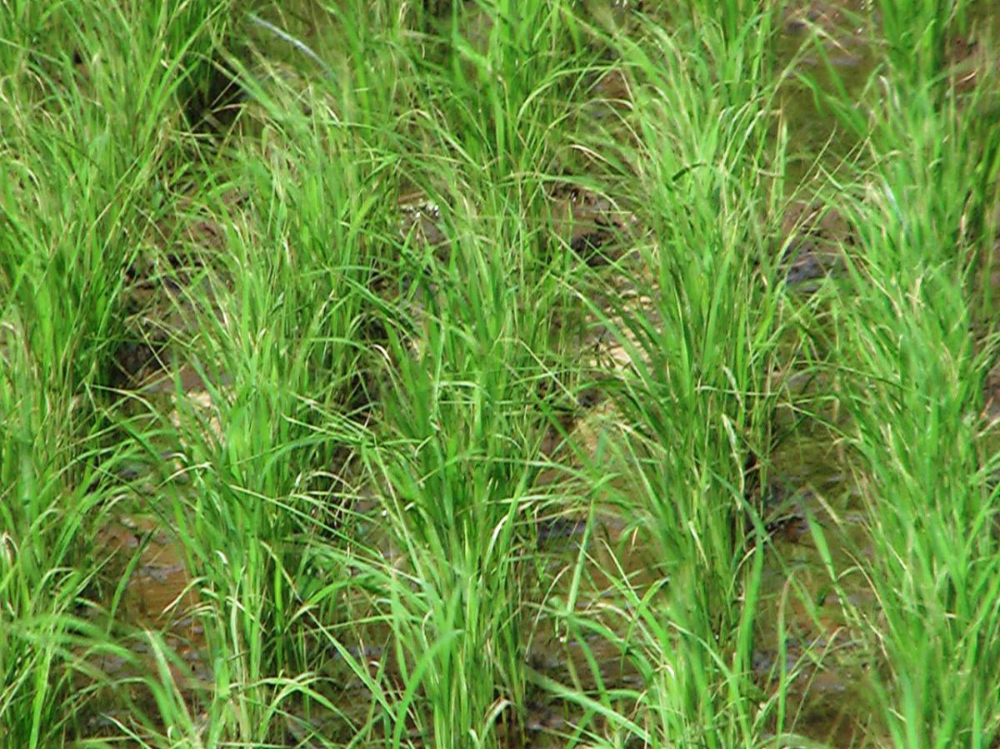

Slide 19
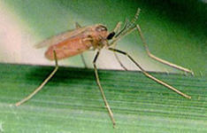
Gallfly

Slide 20
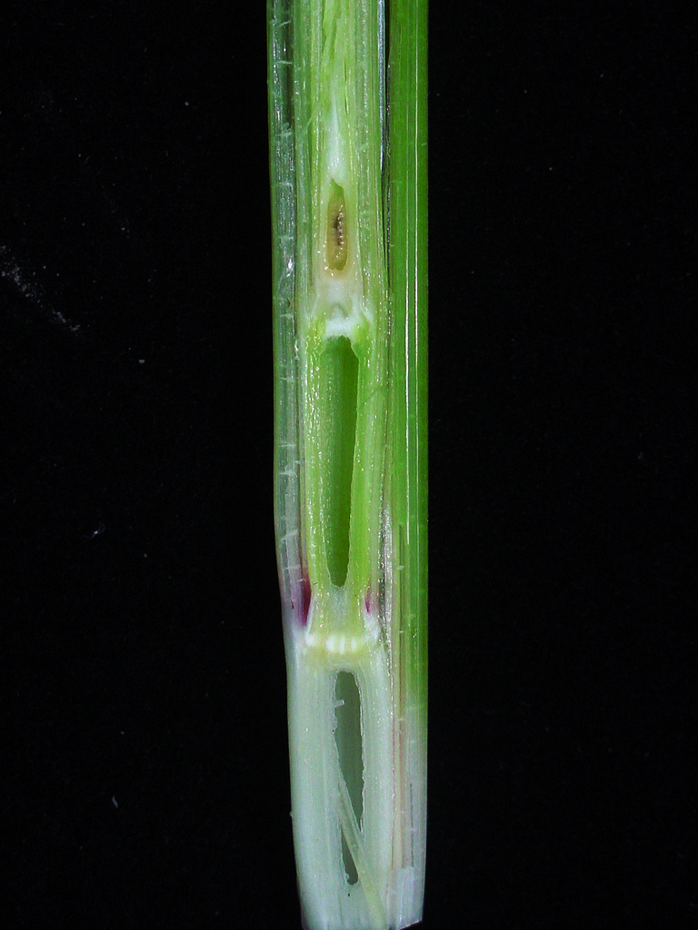

Slide 21
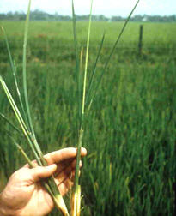

Slide 22
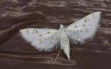
Case worm

Slide 23
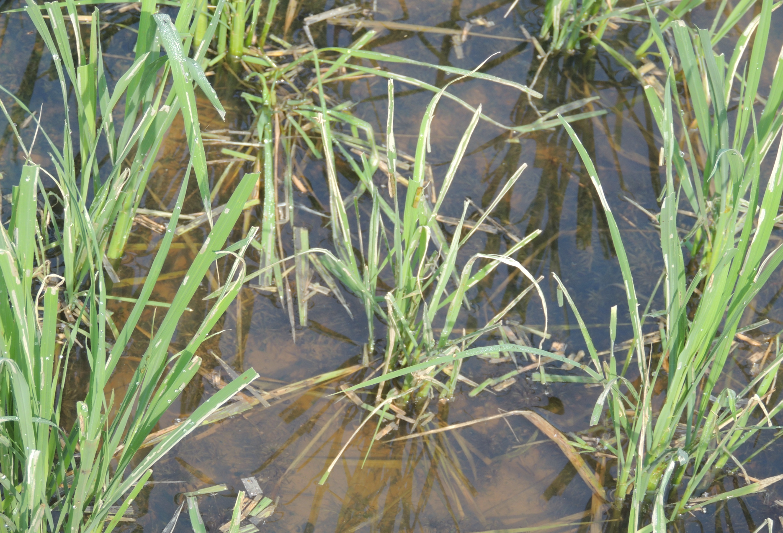

Slide 24
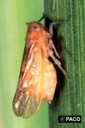
Brown Plant Hopper

Slide 25
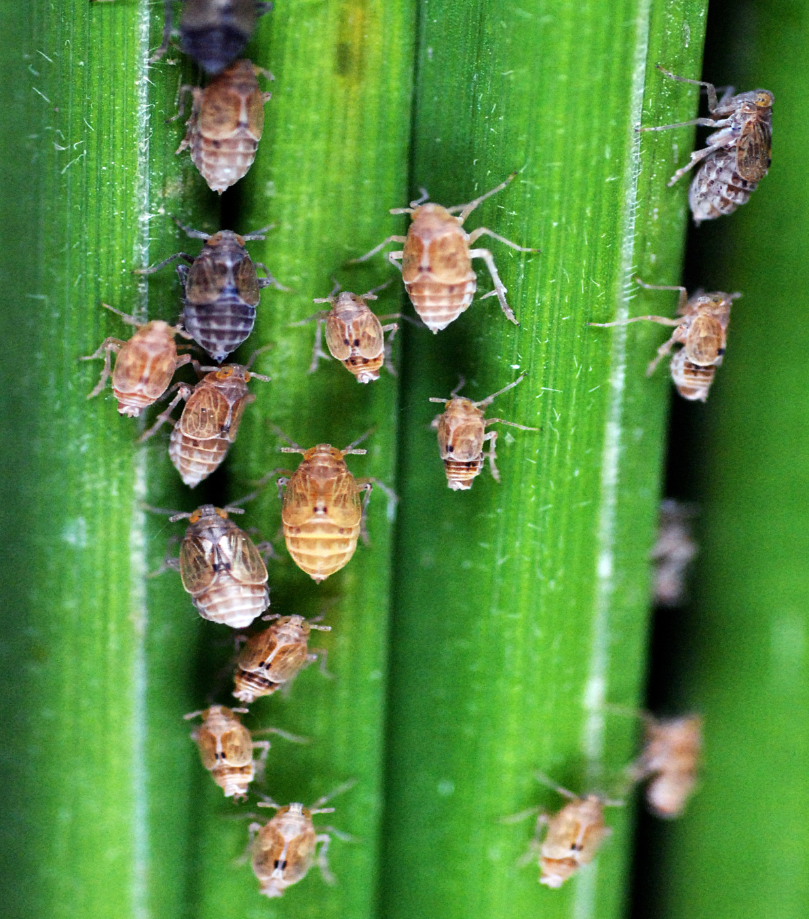

Slide 26
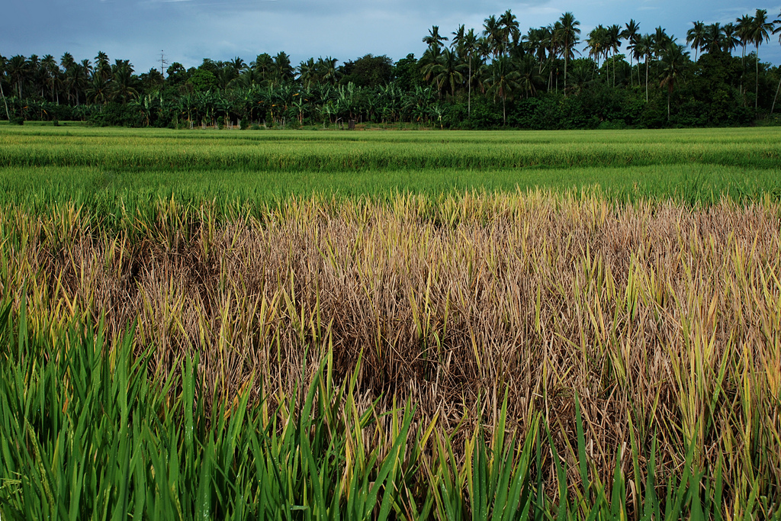

Slide 27
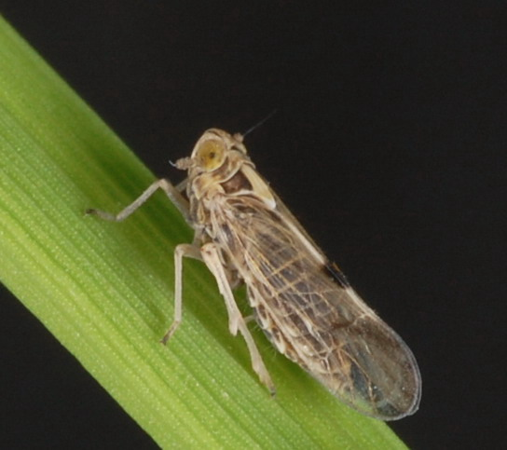

Slide 28
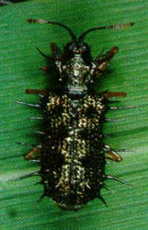
Rice Hispa

Slide 29
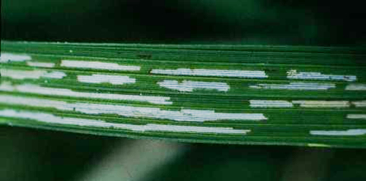

Slide 30
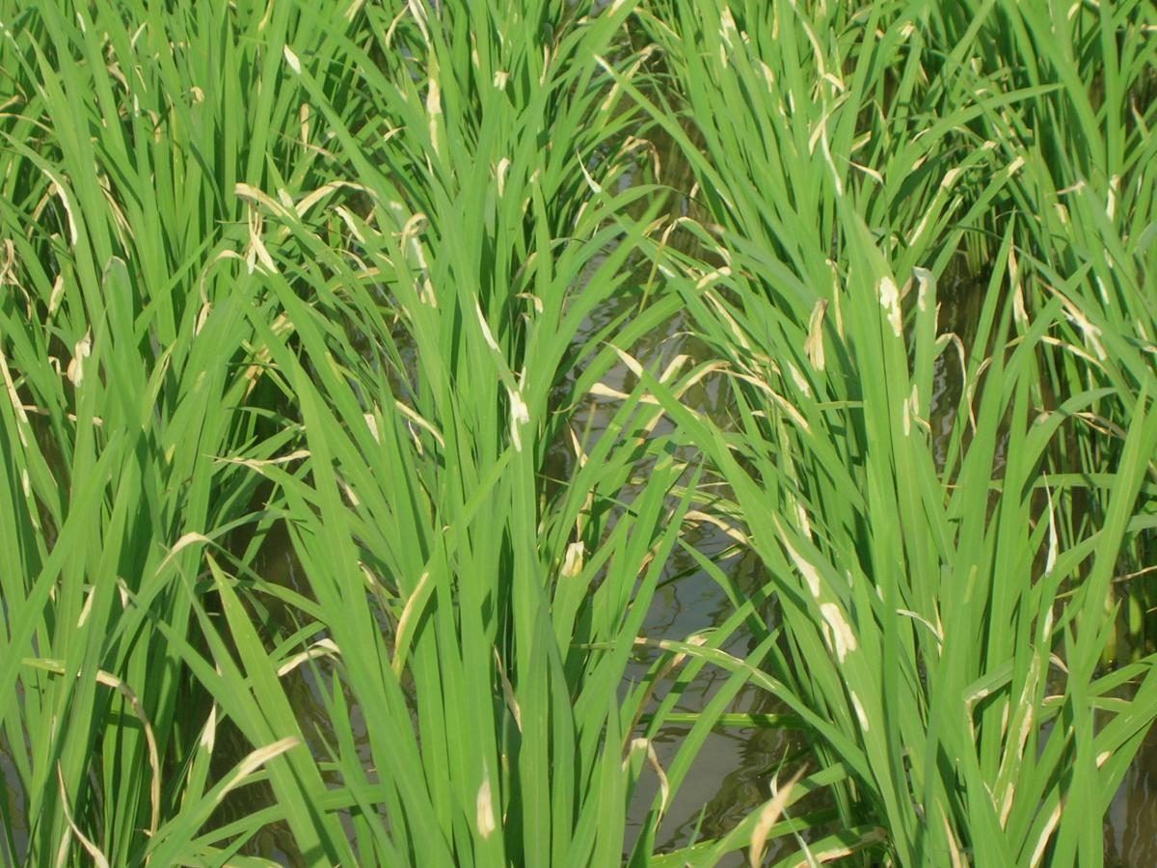

Slide 31
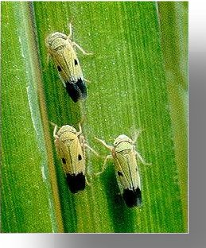
Green leaf Hopper

Slide 32
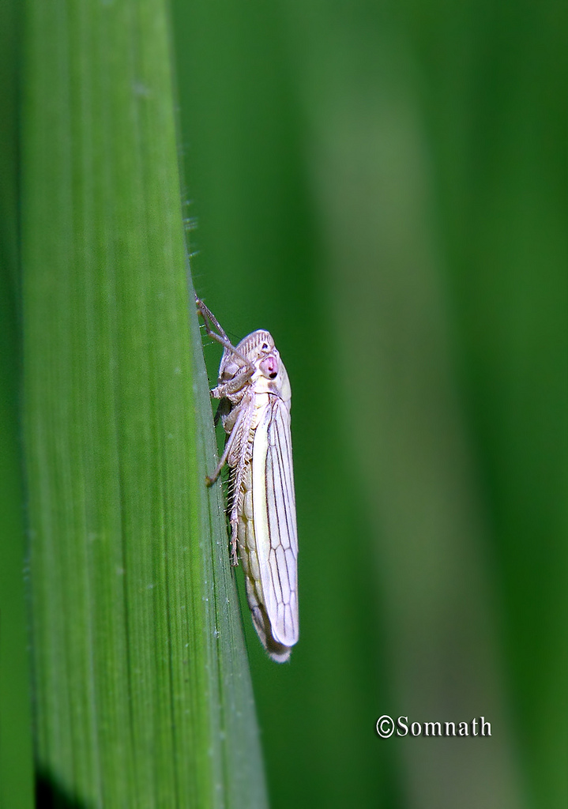

Slide 33
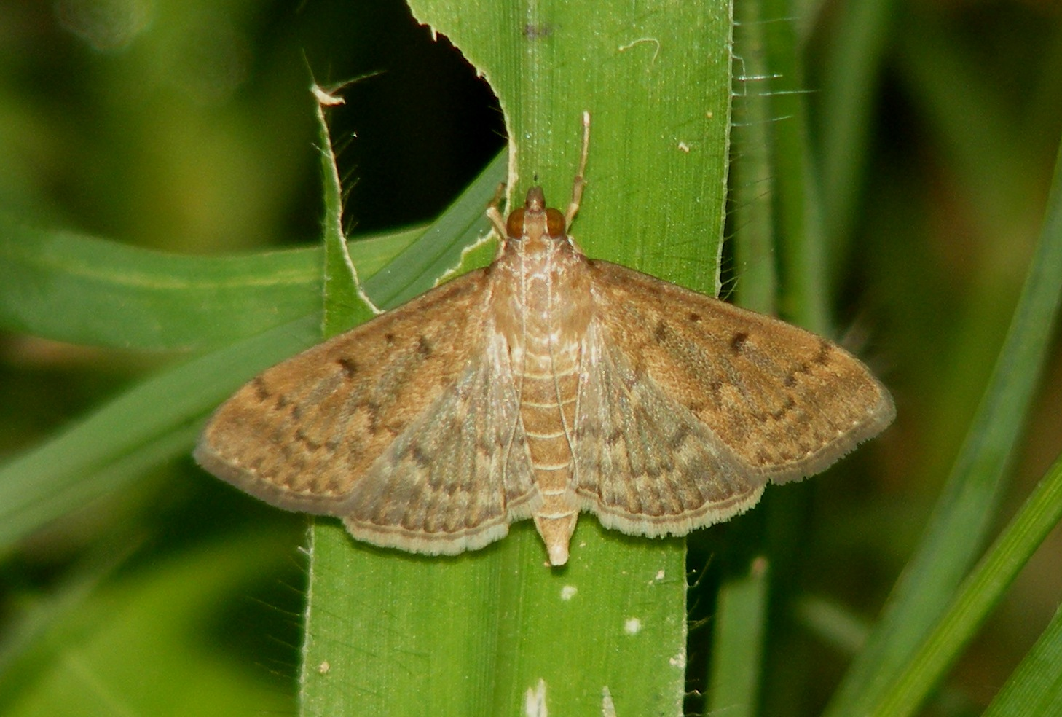
Climbing Cut Worm

Slide 34
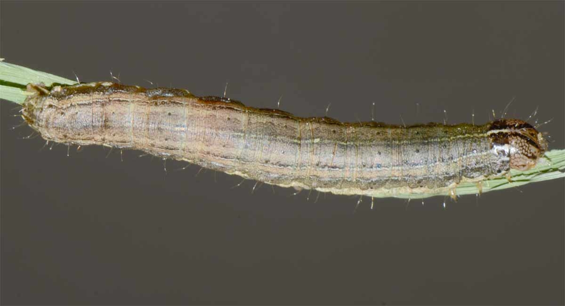

Slide 35
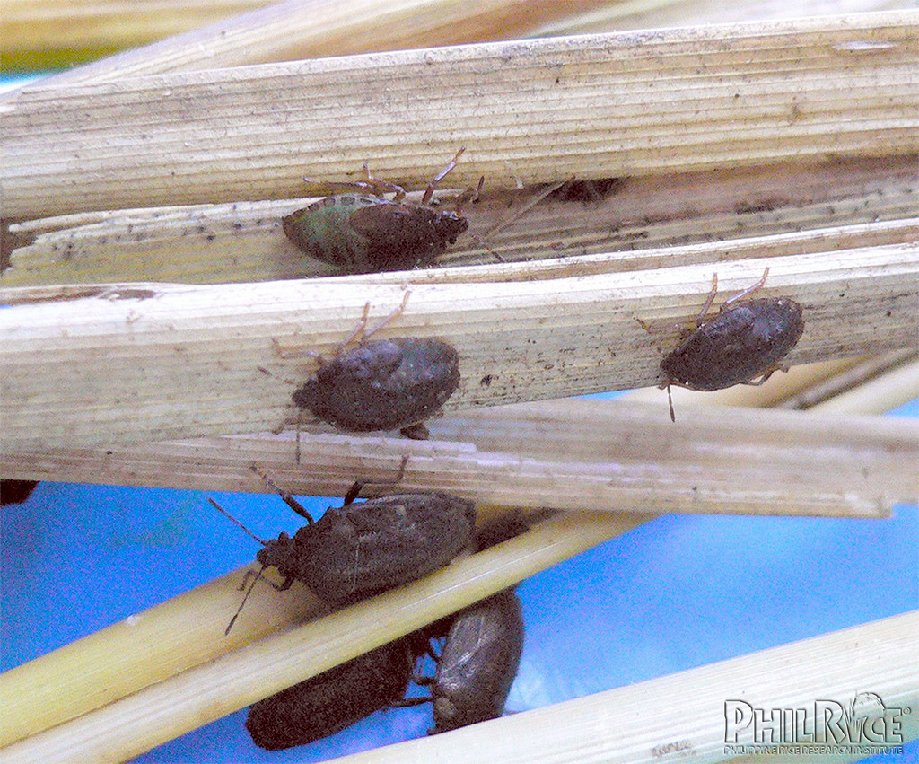
Black Bug

Slide 36
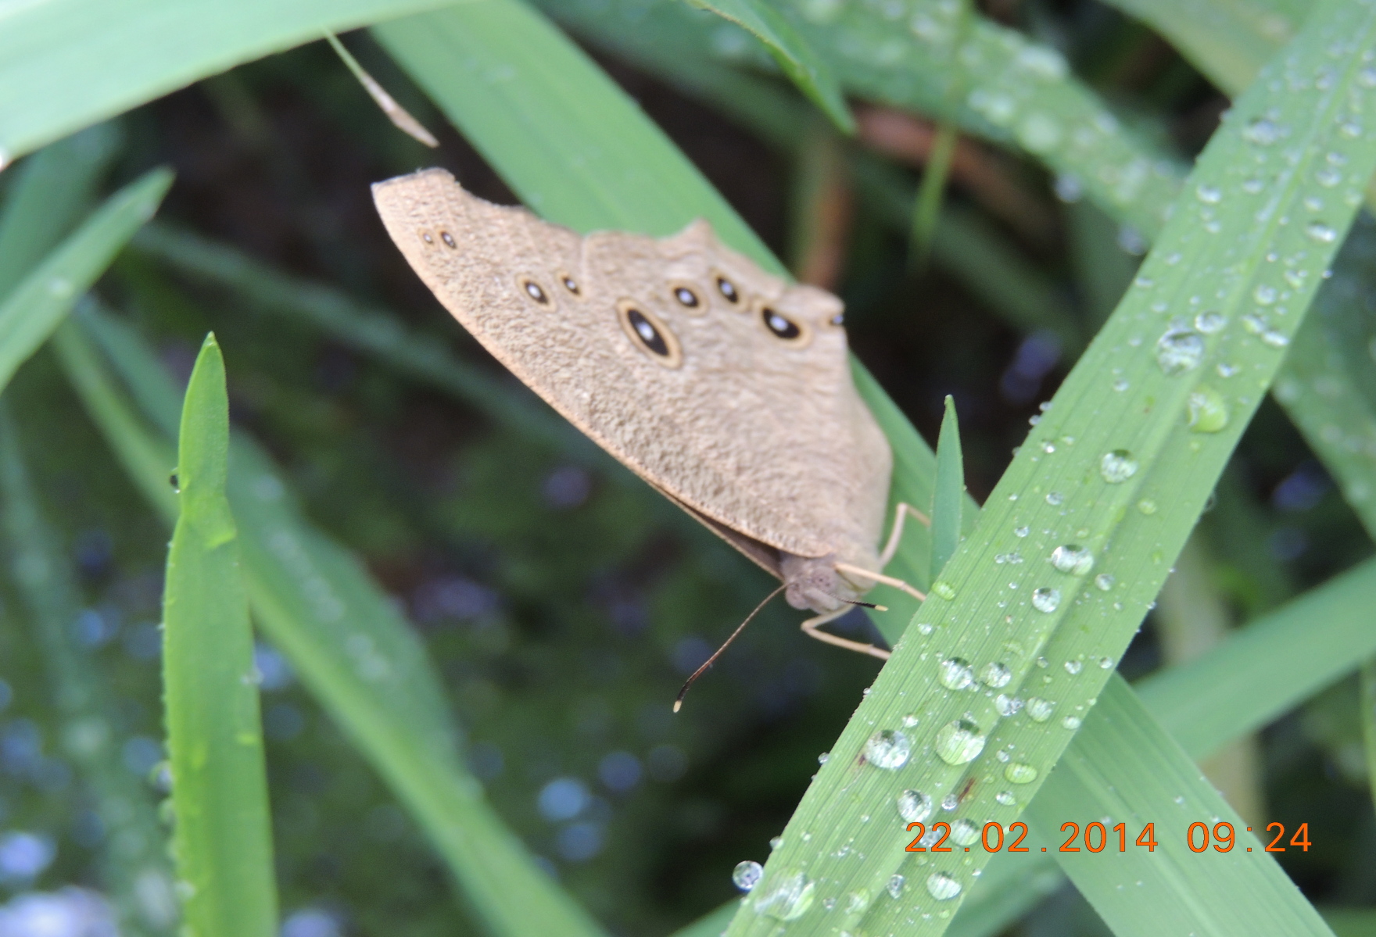

Slide 37
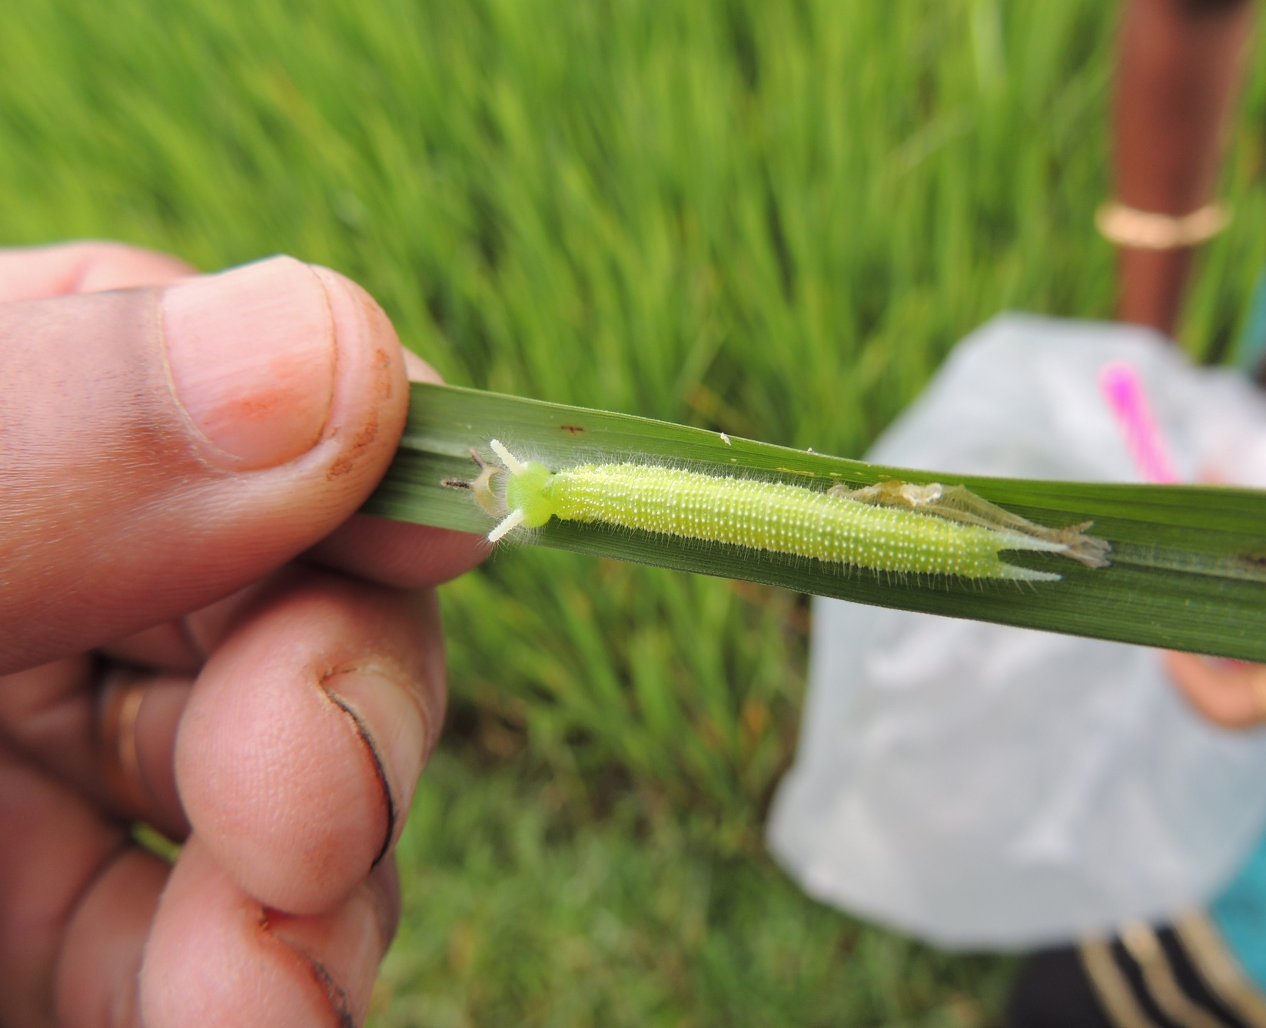

Slide 38
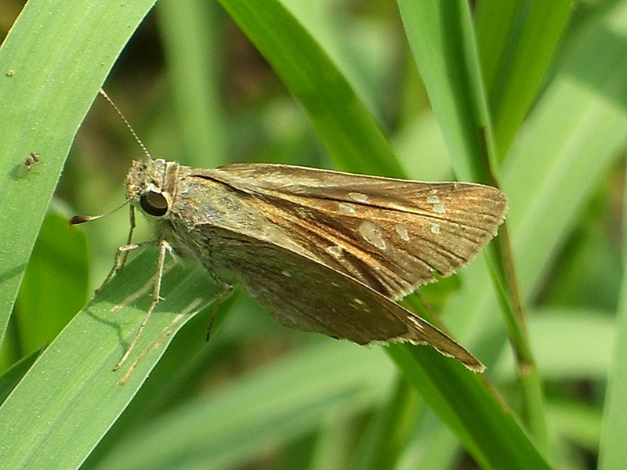

Slide 39
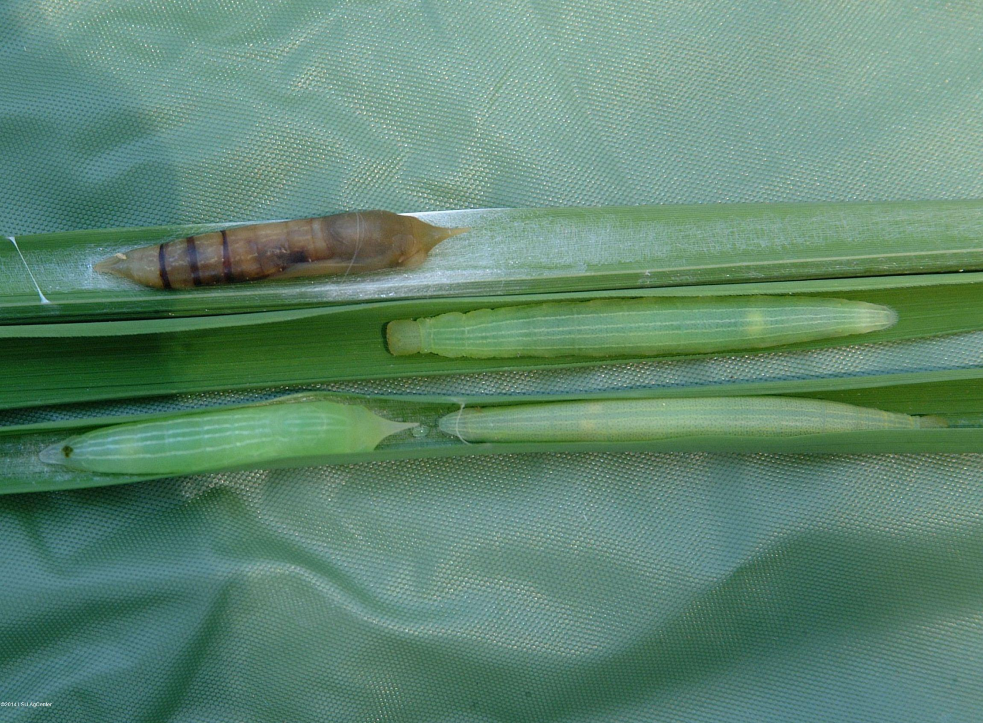

Slide 40
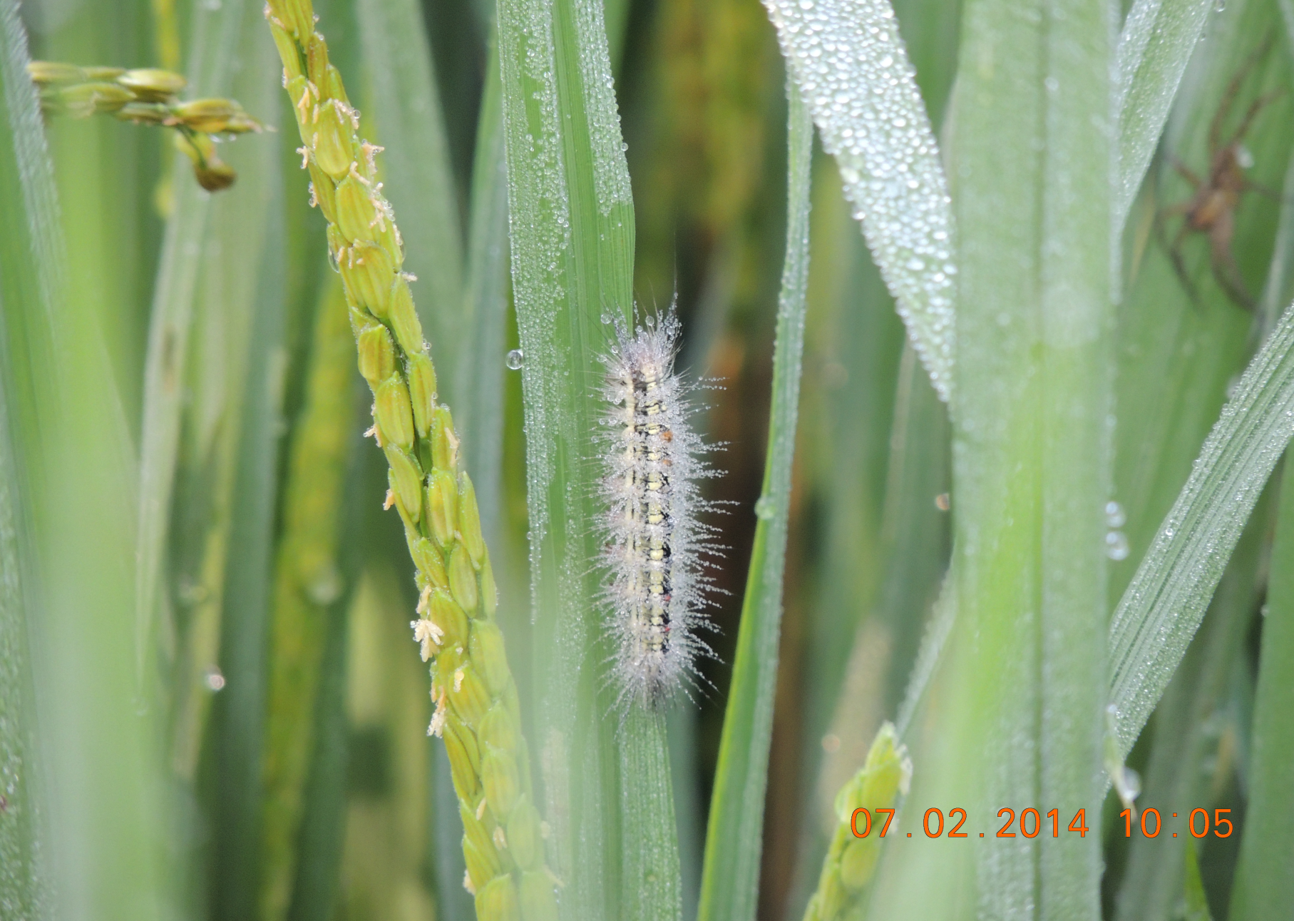

Slide 41
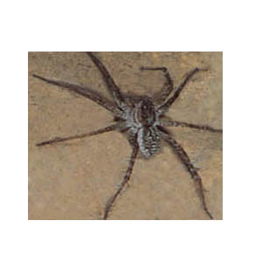
Predators

Slide 42
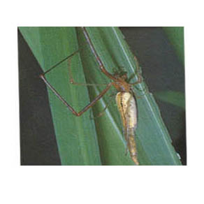

Slide 43
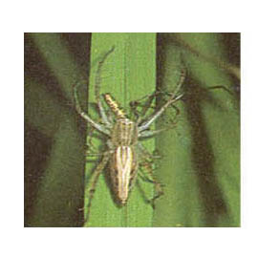

Slide 44
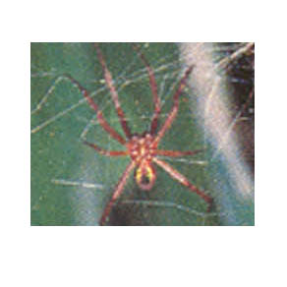

Slide 45
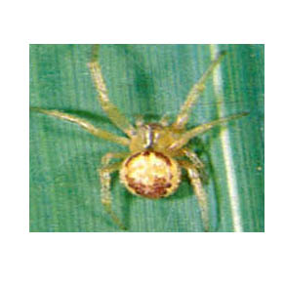

Slide 46
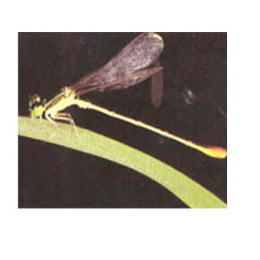

Slide 47
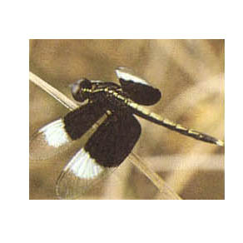

Slide 48
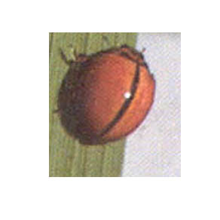

Slide 49
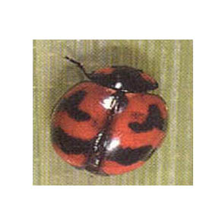

Slide 50
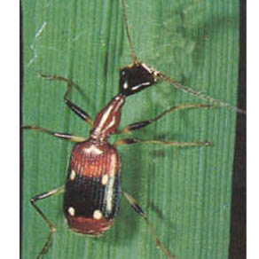

Slide 51
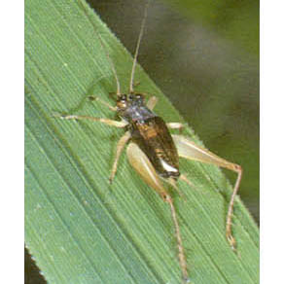

Slide 52
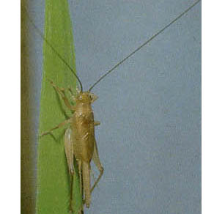

Slide 53
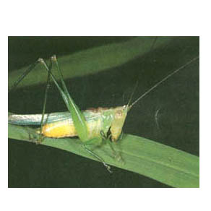

Slide 54
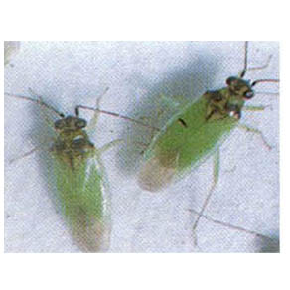

Slide 55
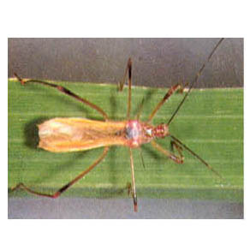

Slide 56


Slide 57


Slide 58


Slide 59

Parasites

Slide 60


Slide 61


Slide 62


Slide 63


Slide 64


Slide 65


Slide 66


Slide 67


Slide 68


Slide 69


Slide 70


Slide 71


Slide 72
Diseases of Rice

Slide 73


Rice Blast – Spindle shaped spots
Nodal Blast – Brown to black lesions

Slide 74

Panicle Blast – Infection on panicle

Slide 75


Brown Leaf Spot- Circular to oval spots
Infection on panicle and grains

Slide 76

Sheath Blight – Sheath infection above water level

Slide 77

Formation of sclerotia on sheaths during wet weather

Slide 78

Sheath Rot- On flag leaf

Slide 79

Sheath rot- Panicle choked/chaffy/partially filled

Slide 80

False Smut – Grains converted in to smut balls

Slide 81

False Smut

Slide 82

Bacterial blight of Rice -

Slide 83


Slide 84

Ooze test

Slide 85

Rice Tungro Virus Disease – Yellow/orange leaf discoloration

Slide 86

Vector of Tungro virus disease – Green Leaf Hopper

Slide 87
Varieties showing multiple tolerance
Varieties showing tolerance | Pests
Pavithra, Panchami, Uma, Karishma, Revathy, Remanika | N. lugens and O. oryzae
Kanakom | N. lugins and S. incertulas
Aruna | N. lugens, S. incertulas, O. oryzae and C. medinalis
Nila | N. lugens, S. incertulas, O. oryzae and B. biformis
Jayanthi | N. lugens and C. medinalis
Bhagya | S. incertulas, C. medinalis and N. depunctalis
Lakshmi | S. incertulas and C. medinalis
Kairali | C. medinalis and O. oryzae

Slide 88
Monitoring
To detect pest infestation in the initial stage
Mechanical measures
Pheromone traps – sex pheromone trap for stem borer
Collection and destruction
Cultural practices
Destruction of stubbles
Avoidance of staggered planting
Dewatering
Flooding

Slide 89
Biological measures
Conservation of the existing parasites and predators
Augmentation
Release of parasites – 50,000/ha
Use of plant products
Neem oil 2%, NeemAzal 0.004%

Slide 90
Arthropod community in untreated rice field

Slide 91
Percentage population of pests, predators, parasitoids and neutrals

Slide 92
Effect of insecticides on total population of pests

Slide 93
Pest
Predators
Parasitoids
Neutrals

Slide 94
Prior concepts of trophic (feeding or energy flow) relationships in rice ecosystem
NATURAL ENEMIES
PESTS
RICE PLANT
POTENTIAL PESTS
Pre-IPM
RICE PLANT
Traditional IPM concept

Slide 95
Rice has three separate pathways for energy supporting natural enemies
NATURAL ENEMIES
HERBIVORES
FILTER-FEEDERS
DETRITIVORES
MICRO-ORGANISM CYCLE
RICE PLANT
Sunlight
ORGANIC MATTER

Slide 96
Functional group relationships among the major elements in the rice community
HERBIVORES
HYPER PARASITOIDS
PREDATORS
PARASITOIDS
FILTER-FEEDERS (Adult Chironomidae, Culicidae)
DETRITIVORES (Adult Diptera, Coleoptera)
RICE PLANT
DETRITIVORES (Surface- Dwelling Collembola)
FILTER FEEDERS (Larvae)
AQUATIC PREDATORS
DETRITIVORES (Aquatic Larvae)
ZOOPLANKTON
BACTERIA
ORGANIC RESIDUE

